Slide 1
Instituto Gulbenkian de Ciência, September 11th- 15th, 2017
INTRODUCTORY BIOSTATISTICS for BIOLOGISTS
Descriptive Statistics
Ana Luisa Papoila, Faculty of Medical Sciences, UNL and Center of Statistics and Applications, University of Lisbon
Fernanda Diamantino, Faculty of Sciences, Center of Statistics and Applications, University of Lisbon
Carina Silva-Fortes, Higher School of Technologies and Health of Lisbon and Center of Statistics and Applications, University of Lisbon
Notes:
Bioestatística I - Parte I

Slide 2
Planning a research study
Identification of a research question
Literature review
Aim and objectives
Methodology
  Variables
  Design
  Identification of sources of bias and potential confounders
  Sampling
  …
Collection and data analysis
Presenting results
Ethical issues: Confidentiality and Anonymity

Slide 3
Types of research studies
Basic and Clinical Research
Basic
Research
Clinical
Research
Improved
Health
Translation from
basic science to
human studies
Translation of
new knowledge
into clinical practice
Adapted from Sung et al. (2003) JAMA, 289, 1278-89.
Copyright © (2003) American Medical Association. All Rights reserved.

Slide 4
Control group
Research study example: experimental trial
Purpose of a control group
To allow discrimination of subjects outcomes (for example, changes in symptoms, signs, or other morbidity) caused by the test “treatment” from outcomes caused by other factors, such as the natural progression of the disease, observer or subject expectations, or other “treatment”.
The control group experiment tells us what would have happened to subjects if they had not received the test “treatment” or if they had received a different “treatment” known to be effective.

Slide 5
Control group
Research study example: experimental trial
A control group in a scientific experiment is a group where the factor being tested is not applied so that it may serve as a standard for comparison against another group where the factor is applied.
A substance that takes part in a biochemical reaction (e.g. blood-clotting factors) or a biological process (e.g. growth factors)

Slide 6
Research study example: experimental trial
A control group is one that is treated in exactly the same way as the experimental group except for the factor that is being investigated.
The test and control groups should be similar with regard to all baseline and on-treatment variables that could influence the outcome, except for the study “treatment” or factor.

Slide 7
Research study example: experimental trial
Testing plant fertilizer:
only half the plants in a garden will receive the fertilizer
Control group
the plants that receive no fertilizer: they establish the baseline level of growth that the fertilizer-treated plants will be compared against.
Without a control group, the experiment cannot determine whether the fertilizer-treated plants grow more than they would have if untreated.

Slide 8
Randomisation
Research study example: experimental trial
The test and control groups should be similar with regard to all baseline and on-treatment variables that could influence the outcome, except for the study “treatment” or factor.
Randomisation
Notes:
Estatística Aplicada à Investigação Clínica-Ensaios Clínicos

Slide 9
Randomisation
Research study example: experimental trial
Reasons for using randomisation to allocate treatments to subjects in a controlled trial:
to prevent biases;
to produce treatment groups in which the distribution of factors that may influence the outcome, known and unknown, are similar.
Douglas G Altman, J Martin Bland. Treatment allocation in controlled trials: why randomise? BMJ 1999; vol 318, pp:1209
Notes:
Bioestatística I - Parte I

Slide 10
Bias
A systematic tendency of any factors associated with the design, conduct, analysis and evaluation of the results of an experimental trial to make the estimate of a “treatment” effect deviate from its true value.
Notes:
Bioestatística I - Ensaios Clínicos

Slide 11
Bias
Research study example: experimental trial
Selection bias (very important!!!!)
Can result when the selection of subjects into a study leads to a result that is different from what you would have gotten if you had enrolled the entire target population
Selection bias refers to systematic differences between baseline characteristics of the groups that are compared.
In experimental trials, selection bias occurs when researchers recruit subjects in ways that abuse the data (interferences from researchers to assign the subjects into groups).
…
Notes:
Estatística Aplicada à Investigação Clínica-Ensaios Clínicos

Slide 12
Bias
Research study example: experimental trial
Performance bias
It refers to systematic differences between groups in the care that is provided, or in exposure to factors other than the interventions of interest (eliminated by using blinding).
Assessment bias
It occurs in studies that rely on subject self-assessment or researcher assessment of subject status (eliminated by using blinding or objective outcome measures).
…

Slide 13
Accuracy and Precision
Accuracy and Precision
Refers to how close a measurement is to a “true” value.
is a measure of the spread of different readings;
refers to how closely individual measurements agree with each other;
Reproducibility
is the degree to which repeated measurements under unchanged conditions show the same results
“repeatable, reliable, getting the same measurement each time.”

Slide 14
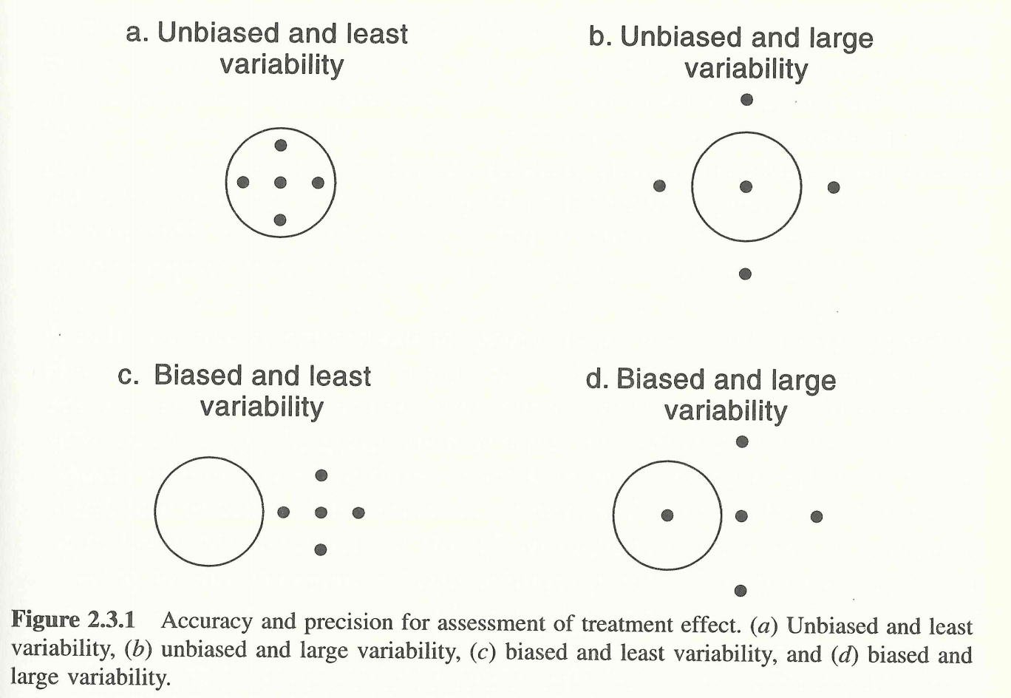
Accuracy and Precision
Shein-Chung Chow and Jen-Pei Liu (1998). Design and analysis of clinical trials, concepts and methodologies. John Wiley and Sons.

Slide 15
Some epidemiological concepts
Confounding
A situation in which a measure of association or relationship between exposure and outcome is distorted by the presence of another variable.

Slide 16
Some epidemiological concepts
Confounding
Exposure
Effect (outcome)
Confounding
variable
Must be associated to the outcome independently of the exposure
Must not be a consequence of the exposure

Slide 17
Some epidemiological concepts
Confounding
Coffee consumption
CHD
Smoking
smoking is associated with coffee consumption and with CHD
it is not a consequence of coffee consumption
it is a risk factor even for those who do not drink coffee.

Slide 18
Some epidemiological concepts
Confounding
Alcohol consumption
CHD
Colesterol HDL
Colesterol HDL is in the causal path between alcohol consumption and CHD.

Slide 19
Some epidemiological concepts
Confounding
How to control confounding?
Study design:
Data analysis:
Randomization
Matching
Restriction
Stratification
Multivariable regression analysis

Slide 20
Some epidemiological concepts
Control variables (also known as "constant variables“)
In the design of experiments and data analysis, control variables are those variables that are not changed throughout the trials in an experiment because the experimenter is not interested in the effect of that variable being changed for that particular experiment. Control variables are extraneous factors, possibly affecting the experiment, that are kept constant so as to minimize their effects on the outcome.
Example:
keeping the pressure constant in an experiment designed to test the effects of temperature on bacterial growth
Control variables, if not monitored, may lead to confounding

Slide 21
Some epidemiological concepts
Interaction
There is interaction when the difference between the levels of a factor depends from the level of other factors.
Effect modification occurs in biomedical research when a measure of statistical association between an exposure and an outcome differs according to the levels of a third variable—the effect modifier.
Biological interaction between two causes occurs if the effect of one depends on the presence of the other.

Slide 22
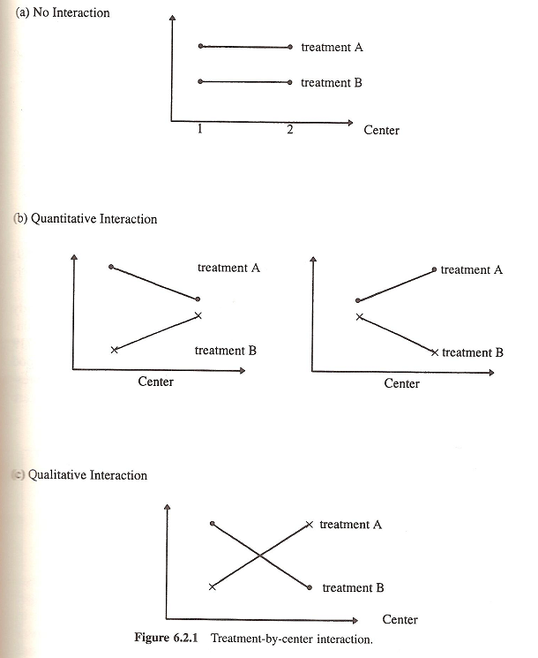
Some epidemiological concepts
Interaction
Quantitative interaction:
The magnitude of the treatment effect is not the same across the levels of other factors but the direction of the treatment remains the same for all levels of other factors.
Qualitative interaction:
The direction of the treatment effect changes in some levels of other factors.

Slide 23
Descriptive Statistics
Basic concepts:
Statistical Analysis typically involves data from a sample to make inferences about the characteristics of a population.
Population: Can be defined as including all items with the characteristic one wishes to understand (also called universe).
Sample: Subset of the population, often chosen randomly and preferably representative of the population as a whole.

Slide 24
Descriptive Statistics
Basic concepts:
Variable: is a characteristic or condition that changes or has different values for different individuals.
Random Variable: is a function that assigns a real number X(s), to each outcome s in a sample. Random Variables are represented by capital letters (e.g. X₁, X₂).
Observation (or case): is a concretization of a variable. For example, the weight of a randomly chosen rat is such an observation (observations are represented by lowercase, e.g. x₁, x₂).

Slide 25
Descriptive Statistics
Basic concepts:
Parameter: is a numeric quantity, usually unknown, that describes a certain population characteristic. For example, the population mean, μ, is a parameter that is often used to indicate the mean value of a quantity (usually are represented by Greek letters, e.g. μ , σ.)

Slide 26
Descriptive Statistics
Basic concepts:
Estimator/Statistic: is a statistic (that is, a function of the data) that is used to infer the value of an unknown parameter in a statistical model.
Estimate/Statistic: An estimate is an indication of the value of an unknown quantity based on observed data. More formally, an estimate is the particular value of an estimator that is obtained from a particular sample of data and used to indicate the value of a parameter.

Slide 27
Descriptive Statistics
Population
Descriptive Statistics
Sample
To organize, describe and summarize sample data
parameters
statistics
Inferential Statistics
Parameter estimation
Hypothesis testing
Draw conclusions about the population from the sample
Notes:
Bioestatística I - Parte I

Slide 28
Descriptive Statistics
Types of data:
Qualitative: data describing the attributes or properties of the data (it can't be measured).
Examples:
  marital status
  stages of a disease
  eye color
  hair color
  …
Notes:
Bioestatística I - Parte I

Slide 29
Descriptive Statistics
Types of data:
Quantitative: data that can be expressed numerically (it can be measured).
Examples:
  temperature
  height
  weight
  …
Notes:
Bioestatística I - Parte I

Slide 30
Descriptive Statistics
Types of data:
Measurement scales
Nominal
Ordinal
Intervalar
Ratio
Qualitative
Quantitative
Notes:
Bioestatística I - Parte I

Slide 31
Descriptive Statistics
Types of data:
Measurement scales
Nominal:
It is classified into categories that describe the characteristic of interest. Each value on the measurement scale has a unique meaning.
Examples:
eye color
gender
marital status
Notes:
Bioestatística I - Parte I

Slide 32
Descriptive Statistics
Types of data:
Measurement scales
Ordinal:
Each value on the measurement scale has a unique meaning and have an ordered relationship to one another.
Examples:
socioeconomic status
stages of a disease
military positions
Notes:
Bioestatística I - Parte I

Slide 33
Descriptive Statistics
Types of data:
Measurement scales
Interval:
It is an ordinal scale in which intervals have the same interpretation throughout. The zero point is arbitrary.
Example:
Fahrenheit scale of temperature:
The difference between 10 degrees and 30 degrees represents the same temperature difference as the difference between 50 degrees and 70 degrees: this is because each 20-degree interval has the same physical meaning
Notes:
Bioestatística I - Parte I

Slide 34
Descriptive Statistics
Types of data:
Measurement scales
Ratio:
It is an interval scale with the additional property that its zero position indicates the absence of the quantity being measured (a minimum value of zero).
OBS: The scale has a true zero point below which no values exist.
Example:
Height
A height of 180 cm doubles a height of 90 cm
Notes:
Bioestatística I - Parte I

Slide 35
Descriptive Statistics
Types of data:
A variable that can take a finite or infinite countable number of numerical values.
Discrete variable:
Example:
Number of …
Obs: nominal and ordinal variables are discrete
Notes:
Bioestatística I - Parte I

Slide 36
Descriptive Statistics
Types of data:
A variable that can take an infinite number of values.
Continuous variable:
Examples:
Height, age, weight, urea levels …
Notes:
Bioestatística I - Parte I

Slide 37
Descriptive Statistics
Types of data:
Exercise:
Gender
Heart pressure
Temperature (Centigrade)
Nº of visits to emergency
Ilness severity
Qualitative, nominal
Quantitative, ratio
Quantitative, interval
Quantitative, ratio
Qualitative, ordinal
Notes:
Bioestatística I - Parte I

Slide 38
Descriptive Statistics
Types of data:
Exercise:
Urea levels
Nº of white blood cells
Glasgow score
Potassium levels
Quantitative, ratio
Quantitative, ratio
Qualitative, ordinal
Quantitative, ratio
Notes:
Bioestatística I - Parte I

Slide 39
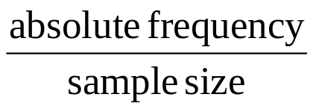
Descriptive Statistics
Organizing data:
Discrete data:
Frequency table
Absolute frequency of each different value
Relative frequency =
Notes:
Bioestatística I - Parte I

Slide 40
Descriptive Statistics
Organizing data:
Example: response to a treatment
response | good | moderate | poor
Nº patients | 50 | 36 | 15
Frequency table
classes | Abs. freq. | Rel. freq. | Cum. freq.
god moderate poor | 50 36 15 | 0.495 0.356 0.149 | 0.495 0.851 1.000
Total | 101 | 1.000
Notes:
Bioestatística I - Parte I

Slide 41
Descriptive Statistics
Organizing data:
Continuous data:
Frequency distribution
grouping data into classes
Find the range
Select the number of classes (e.g. Sturges’ Rule)
Determine the class width
Define the class limits
Count the number of observations in each class
Calculate relative and cumulative frequencies of each class
Notes:
Bioestatística I - Parte I

Slide 42
Descriptive Statistics
Organizing data:
Classes | Abs. freq. | Rel. freq.
[-100.5, -80.5[ [-80.5, -60.5[ [-60.5, -40.5[ [-40.5, -20.5[ [-20.5, -0.5[ [-0.5, 19.5[ [19.5, 39.5[ [39.5, 59.5[ | 1 6 16 31 40 43 16 3 | 0.01 0.04 0.10 0.20 0.26 0.28 0.10 0.02
Example:
Changes in serum cholesterol levels after administration of a drug which aims to reduce cholesterol levels.
Total 156 1
Notes:
Bioestatística I - Parte I

Slide 43
Descriptive Statistics
tables and graphics
How to summarize data?
statistics
Statistical measures calculated from data
Types of statistical measures:
measures of location
measures of dispersion (variability)
measures of shape
Notes:
Bioestatística I - Parte I

Slide 44
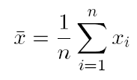
Descriptive Statistics
Measures of location
Sample Mean
Mode
Median
is the value in the middle when observations are arranged in ascending order. With an odd number of observations, the median is the middle value. With an even number of observations the median is the average of the two middle observations.
is the value that occurs most frequently in the data. The mode is a useful way to summarize qualitative data.
Notes:
Bioestatística I - Parte I

Slide 45
Descriptive Statistics
Measures of location
Quantiles
Each of any set of values of a variable which divides a frequency distribution into equal groups, each containing the same fraction of the total population.

Slide 46
Descriptive Statistics
Measures of location
Quantiles - Examples
Quartiles (Q): one of the values of a variable that divides the distribution of the variable into four groups having equal frequencies
Deciles (D):
one of the values of a variable that divides the distribution of the variable into ten groups having equal frequencies
Percentiles (P): one of the values of a variable that divides the distribution of the variable into 100 groups having equal frequencies

Slide 47
Descriptive Statistics
Measures of location
First (lower) decile = 10th percentile (P₁₀)
First (lower) quartile, Q₁= 25th percentile (P₂₅)
Second (middle) quartile, Q₂ = 50th percentile (P₅₀)
Third quartile, Q₃ = 75th percentile (P₇₅)
Ninth (upper) decile = 90th percentile (P₉₀)

Slide 48
Descriptive Statistics
Measures of location
the mean is not a resistant measure of central tendency
It is influenced by extremely high or low data values (outliers)
median
alternative
Notes:
Bioestatística I - Parte I

Slide 49
Descriptive Statistics
Measures of location
mean or median?
when the distribution is symmetric, mean and median are equal
the median is not so sensitive to outliers
the mean reflects the value of all the observations
Notes:
Bioestatística I - Parte I

Slide 50

Descriptive Statistics
Measures of dispersion
Are statistical measures that summarise the amount of spread or variation in the distribution of values in a variable.
sample variance s² =
sample standard deviation s
ranges (e.g. range, interquartile range)
Difference between the maximum and the minimum
Difference between Q₃ and Q₁
Notes:
Bioestatística I - Parte I

Slide 51
Descriptive Statistics
Measures of dispersion
the standard deviation is not a resistant measure
It is influenced by extremely high or low data values (outliers)
Interquartile range
alternative
The interquartile range is a more resistant measure than the standard deviation because it is not so sensitive to the data
however
It doesn’t reflect the value of all the observations
Notes:
Bioestatística I - Parte I

Slide 52
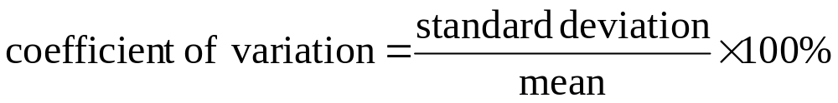
Descriptive Statistics
Measure of relative dispersion
  how big is the SD relative to the mean?
the value of the CV is independent of the unit in which the measurement has been taken, so it is a dimensionless (unitless) number
useful for comparing the variability of data with different units or widely different means

Slide 53
Descriptive Statistics
Concluding:
When the mean is used as a location measure
use the standard deviation as the dispersion measure
When the median is used as a location measure
use the interquartile range as the dispersion measure
Notes:
Bioestatística I - Parte I

Slide 54
Descriptive Statistics
Measures of Shape
Positively skewed (skewed to the right)
Symmetric
Negatively skewed (skewed to the left)
Skewness measures departure from symmetry
Leptokurtic
Mesokurtic
Platykurtic
Kurtosis measures the “peakedness” of a distribution
Notes:
Bioestatística I - Parte I

Slide 55
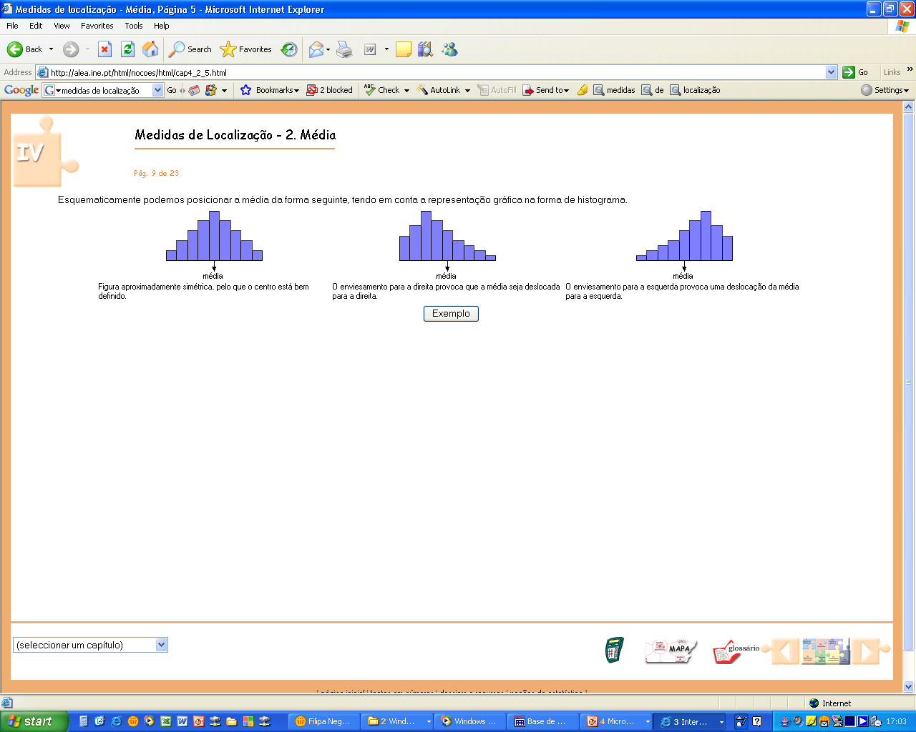
Descriptive Statistics
Measures of Shape - Skewness
Positively skewed
(mean > median > mode)
Skewness coefficient > 0
Mean
Symmetric
(mean = median = mode)
Skewness coefficient = 0
Mean
Negatively skewed
(mean < median < mode)
Skewness coefficient < 0
Mean
Notes:
Bioestatística I - Parte I

Slide 56
Descriptive Statistics
Measures of Shape - Kurtosis
Leptokurtic
Mesokurtic
Platykurtic
Kurtosis coefficient > 0
Kurtosis coefficient = 0
Kurtosis coefficient < 0
sharper than a Gaussian distribution, with values concentrated around the mean
like Gaussian distribution
flatter than a Gaussian distribution with a wider peak
Notes:
Bioestatística I - Parte I

Slide 57
Descriptive Statistics
Graphing data:
Discrete data
e.g. Barplots
A barplot draws a bar with a height proportional to the count in the table. The height could be given by the frequency, or by the proportion. The graph will look the same, but the scales may be different.
The bars are not contiguous (touching one another) nor do the areas of the strips have a meaning; rather, the heights of the rectangles are proportional to the frequency.

Slide 58
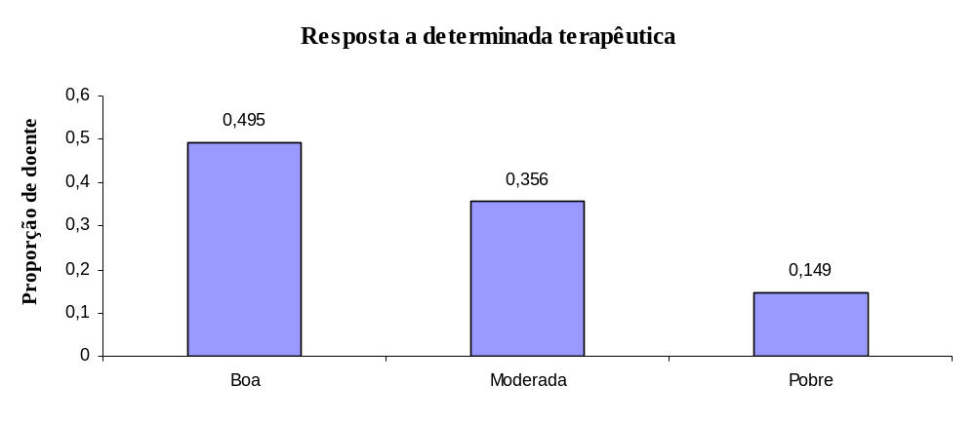
Descriptive Statistics
Graphing data:
Example: response to a treatment
response | good | moderate | poor
Nº patients | 50 | 36 | 15
Proportion of patients
good
moderate
good
n = 101
Notes:
Bioestatística I - Parte I

Slide 59
Descriptive Statistics
Graphing data:
Continuous data
Histogram
It reflects the shape of the population distribution
Example:
Changes in serum cholesterol levels after administration of a drug which aims to reduce cholesterol levels.
Notes:
Bioestatística I - Parte I

Slide 60
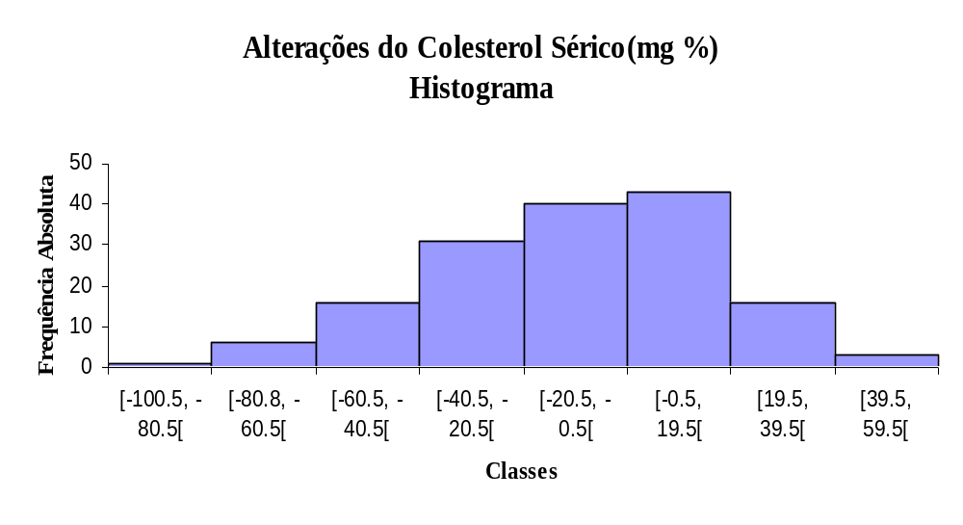
Descriptive Statistics
Graphing data:
Histogram
Absolute frequency
25
20
a
i
15
c
n
e
u
q
e
r
F
10
5
0
-100.00
-50.00
0.00
50.00
n = 156
Classes
Notes:
Bioestatística I - Parte I

Slide 61
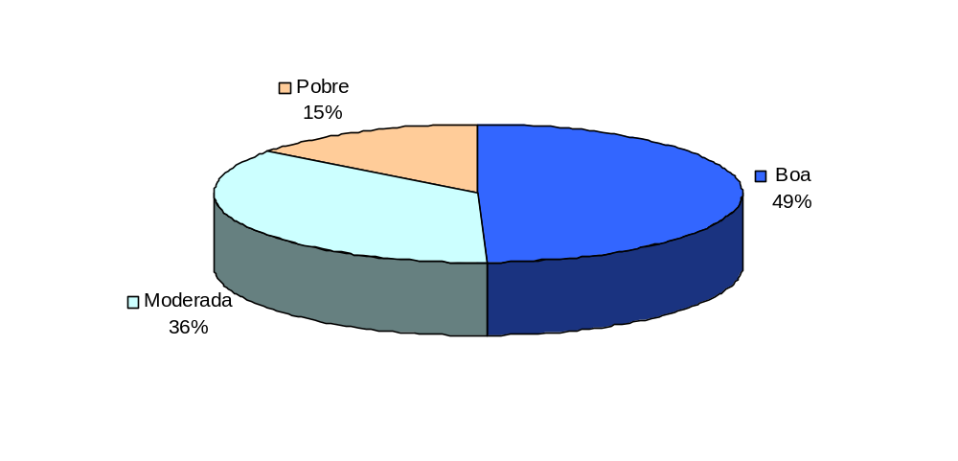
Descriptive Statistics
Graphing data:
Pie chart:
Each class corresponds to each slice, and the slice areas are proportional to the frequencies.
Example:
response to a treatment
Poor
Good
n = 101
Notes:
Bioestatística I - Parte I

Slide 62
Descriptive Statistics
Graphing data:
Error bars:
Figures with error bars can, if used properly, give information describing the data (descriptive statistics), or information about what conclusions, or inferences, are justified (inferential statistics).
These two basic categories of error bars are depicted in exactly the same way, but are actually fundamentally different.

Slide 63
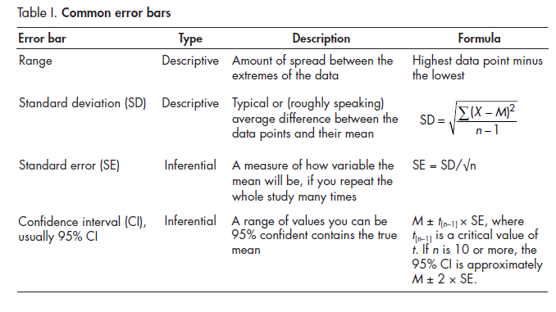
Descriptive Statistics
Graphing data:
Error bars:
Source: Cumming et al. (2007)

Slide 64
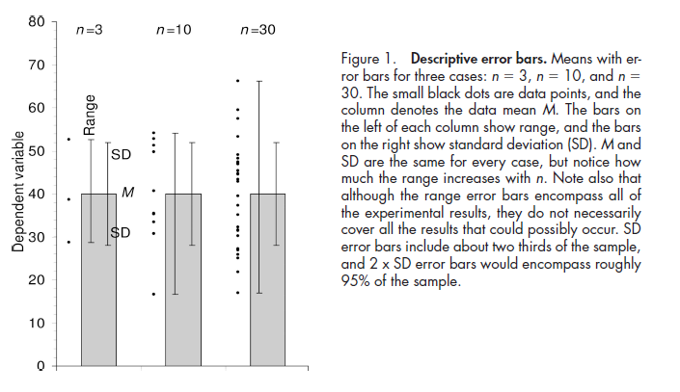
Descriptive Statistics
Graphing data:
Descriptive error bars:
Range and standard deviation (SD) are used for descriptive error bars because they show how the data are spread.
Source: Cumming et al. (2007)

Slide 65
Descriptive Statistics
Graphing data:
Inferential error bars:
In experimental biology it is more common to be interested in comparing samples from two groups, to see if they are different.
For example, you might be comparing wild-type mice with mutant mice, or drug with placebo, or experimental results with controls. To make inferences from the data (i.e., to make a judgment whether the groups are significantly different, or whether the differences might just be due to random fluctuation or chance), a different type of error bar can be used. These are standard error (SE) bars and confidence intervals (CIs) bars.

Slide 66
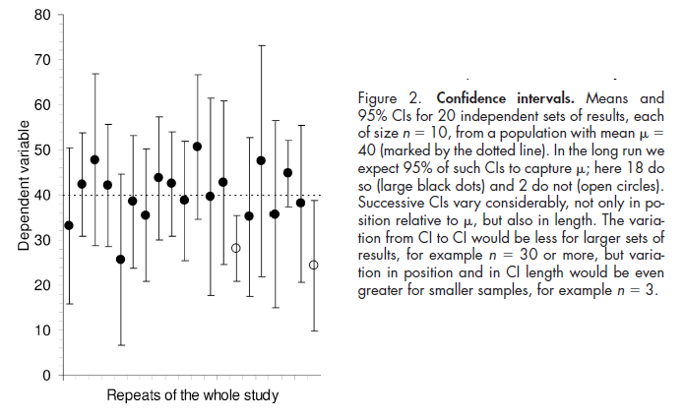
Descriptive Statistics
Graphing data:
Inferential error bars:
Source: Cumming et al. (2007)

Slide 67
Descriptive Statistics
Graphing data:
Error bars:
Rule 1: when showing error bars, always describe in the figure legends what they are.
Rule 2: the value of n (i.e., the sample size, or the number of independently performed experiments) must be stated in the figure legend. It is essential that n (the number of independent results) is carefully distinguished from the number of replicates, which refers to repetition of measurement on one individual in a single condition, or multiple measurements of the same or identical samples.

Slide 68
Descriptive Statistics
Graphing data:
Error bars - replicates:
Consider trying to determine whether deletion of a gene in mice affects tail length. We could choose one mutant mouse and one wild type, and perform 20 replicate measurements of each of their tails. We could calculate the means, SDs, and SEs of the replicate measurements, but these would not permit us to answer the central question of whether gene deletion affects tail length, because n would equal 1 for each genotype, no matter how often each tail was measured.
For replicates, n = 1, and it is therefore inappropriate to show error bars or statistics.

Slide 69
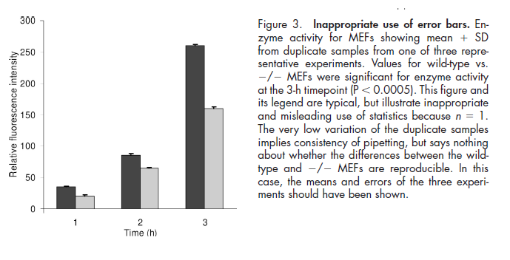
Descriptive Statistics
Graphing data:
Error bars - replicates:
Rule 3: error bars and statistics should only be shown for independently repeated experiments, and never for replicates. If a "representative" experiment is shown, it should not have error bars or p-values, because in such an experiment, n = 1.

Slide 70
Descriptive Statistics
Graphing data:
Error bars:
Rule 4: because experimental biologists are usually trying to compare experimental results with controls, it is usually appropriate to show inferential error bars, such as SE or CI, rather than SD. However, if n is very small (for example n = 3), rather than showing error bars and statistics, it is better to simply plot the individual data points.

Slide 71
Descriptive Statistics
Graphing data:
Error bars - some considerations:
When first seeing a figure with error bars, ask yourself: "What is n? "Are they independent experiments, or just replicates?" and, "What kind of error bars are they?“
If the figure legend gives you satisfactory answers to these questions, you can interpret the data, but remember that error bars and other statistics can only be a guide: you also need to use your biological understanding to appreciate the meaning of the numbers shown in any figure.

Slide 72
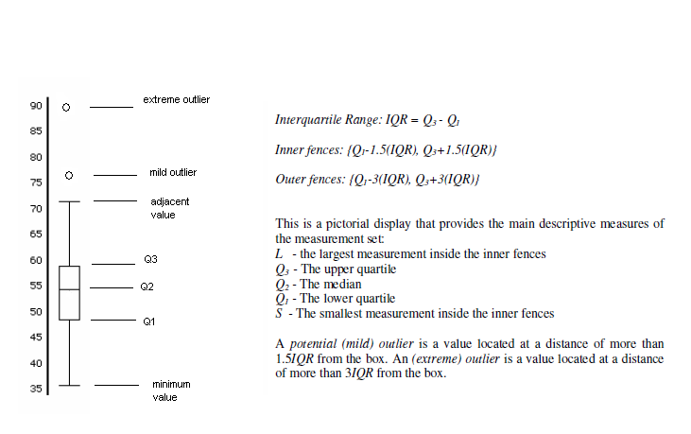
Descriptive Statistics
Graphing data:
Boxplot:

Slide 73
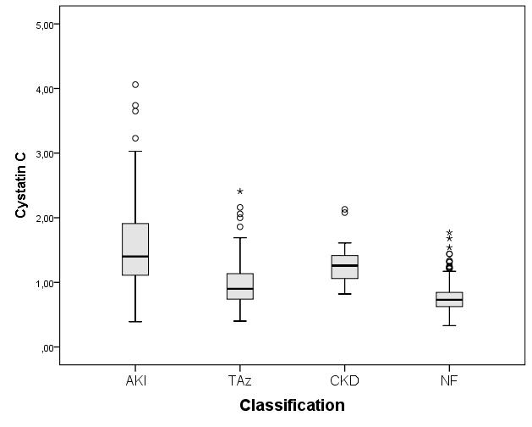
Descriptive Statistics
Graphing data:
Parallel Boxplot:
It is often useful to compare data from two or more groups by viewing box plots from the groups side by side.
OBS: Cystatin C is mainly used as a biomarker of kidney function

Slide 74
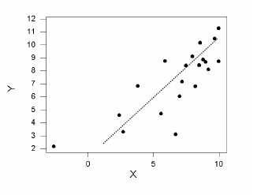
Descriptive Statistics
Graphing data:
Scatter Diagrams:
Often we are interested in the relationships between two quantitative variables.
Typical Patterns:
Positive linear relationship:
if X increases then Y increases and vice versa.

Slide 75
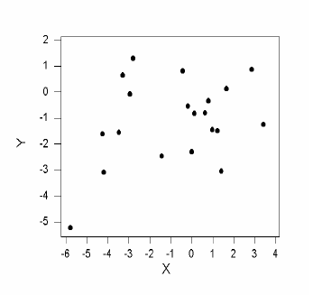
Descriptive Statistics
Graphing data:
Scatter Diagrams:
Typical Patterns:
No relationship

Slide 76
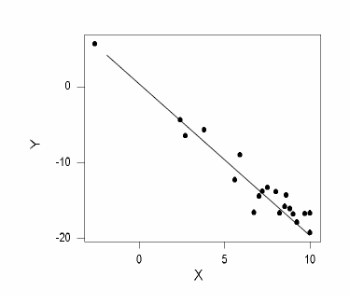
Descriptive Statistics
Graphing data:
Scatter Diagrams:
Typical Patterns:
Negative linear relationship:
if X increases then Y decreases and vice versa.

Slide 77
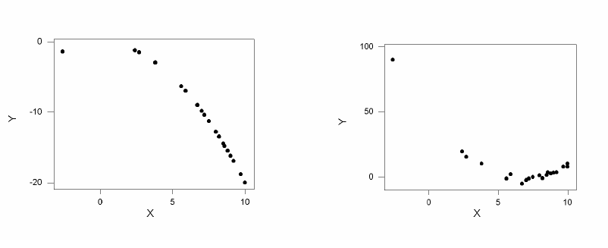
Descriptive Statistics
Graphing data:
Scatter Diagrams:
Typical Patterns:
Nonlinear (e.g. concave) relationship (sometimes not so easy to identify)

Slide 78
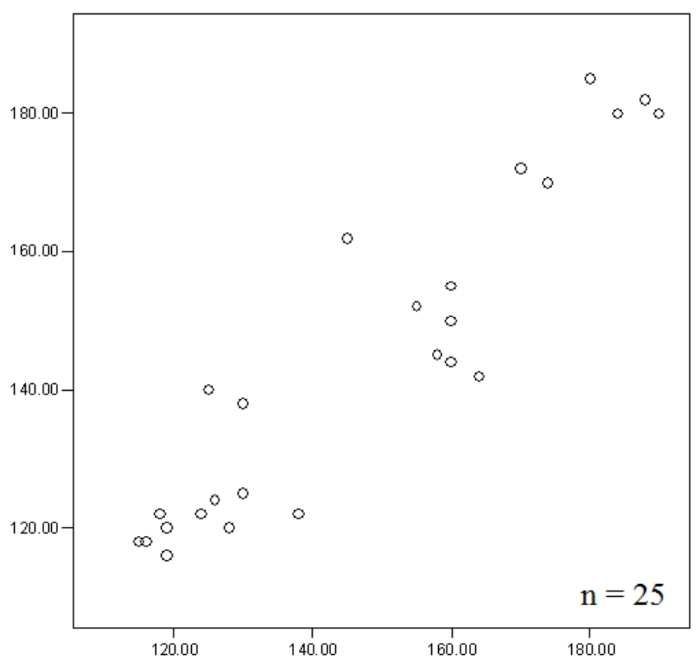
Descriptive Statistics
Graphing data:
Scatter Diagrams:
Example: systolic blood pressure of 25 pairs of identical twins
SBP 1st twin
SBP 2nd twin
Notes:
Bioestatística I - Parte I

Slide 79
Descriptive Statistics
Measures of association:
Correlation is there a linear association between two quantitative variables? How strong is this relationship?
Correlation coefficient - ρ (-1 ≤ ρ ≤ 1)
If ρ > 0 positive linear relationship
If ρ < 0 negative linear relationship
If ρ = 0 no linear relationship

Slide 80
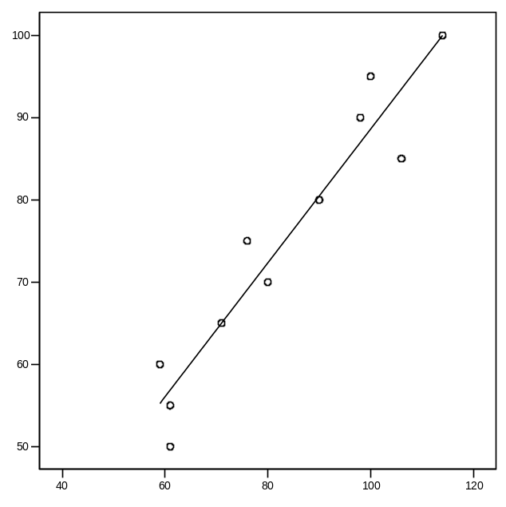
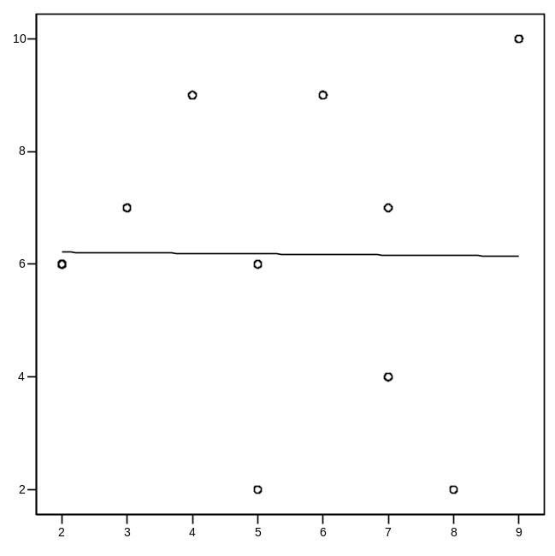
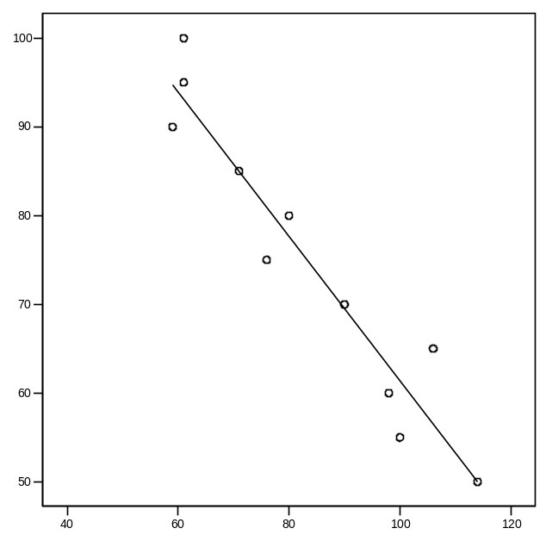
Descriptive Statistics
Measures of association:
ρ > 0
ρ = 0
ρ < 0
Direct relationship
Linear independence
Inverse relationship
Notes:
Estatística Aplicada à Investigação Clínica-Parte II

Slide 81
Descriptive Statistics
Measures of association:
Correlation coefficients:
Pearson’s correlation coefficient (Normality assumed)
Spearman’s rank correlation coefficient*
* for ordinal categorical variables at least; when Normality assumption is not verified.
Notes:
Estatística Aplicada à Investigação Clínica-Parte II

Slide 82
Descriptive Statistics
Measures of association:
Misuses of the correlation coefficient:
It is incorrect to calculate a simple correlation coefficient for data which include more than one observation on some or all of the subjects, because such observations are not independent.
Correlation is inappropriate for comparing alternative methods of measurements of the same variable, because it assesses association not agreement.
Regression and correlation are separate techniques serving different purposes and need not automatically accompany each other.

Slide 83
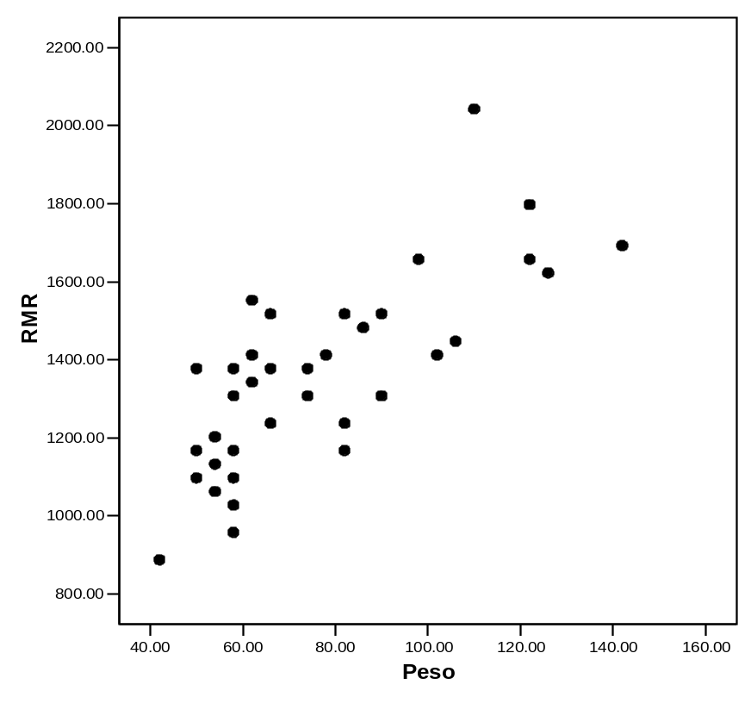
Descriptive Statistics
Measures of association:
Example:
Relationship between weight (kg) and basal metabolic rate (RMR) (kcal/24 hr)
r = 0.744
RMR is an estimate of how many calories you would burn if you were to do nothing but rest for 24 hours. It represents the minimum amount of energy required to keep your body functioning, including your heart beating, lungs breathing, and body temperature normal.
Weight
Point estimate of ρ
Notes:
Estatística Aplicada à Investigação Clínica-Parte II

Slide 84
Descriptive Statistics
Exercise:
The following data concerns weights (ounces) of malignant tumors from 57 patients. Perform a descriptive study with this data.
12 12 12 16 19 21 22 22 23 23 | 23 24 24 25 25 25 27 27 27 27 | 28 28 28 28 30 30 31 31 32 32 | 36 36 38 38 42 42 42 43 43 43 | 44 45 46 47 49 49 49 50 51 51 | 57 63 65 68 69 74 79
Notes:
Bioestatística I - Parte I

Slide 85
Multiple choice questions
Notes:
Bioestatística I - Parte I

Slide 86
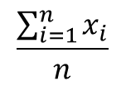
Multiple choice questions
Each statement is either true or false.
The mean of a large sample of size n
Is always greater than the median
It is calculated from the formula
Estimates the population mean with greater precision than the mean of a small sample.
Increases as the sample size increases
Is always greater than the standard deviation

Slide 87
Multiple choice questions
The following are measures of the spread of a distribution:
1. Interquantile range
Standard deviation
Range
Median
Mode
As the size of a random sample increases:
1. The standard deviation decreases
The standard error of the mean decreases
The mean decreases
The accuracy of the parameter estimates increases

Slide 88
Multiple choice questions
A correlation coefficient:
1. Always lies in the range 0-1
Can be use to predict one variable from another
Could be used to summarize the relationship between haemoglobin concentration and blood group in a sample of hospital patients
Is a measure of the extent to which two continuous variables are linearly related

Slide 89
Bibliography
Altman, D. (1991). Practical statistics for medical research. First edition. Chapman & Hall, London.
Bland, M. (2000). An introduction to medical statistics. Oxford University Press.
Daniel, Wayne and Cross, Chad (2013). Biostatistics: A Foundation for Analysis in the Health Sciences. Third edition. Oxford University Press.
Cummimg, G., Fidler, F. and Vaux, D. L. (2007). Error bars in experimental biology. The Journal of Cell Biology, 177(1):7-11.
Notes:
Bioestatística I - Parte I

